Slide 1

Analysis Studies for GSI2021 campaign
7/09/2022
Giacomo Ubaldi

Slide 2
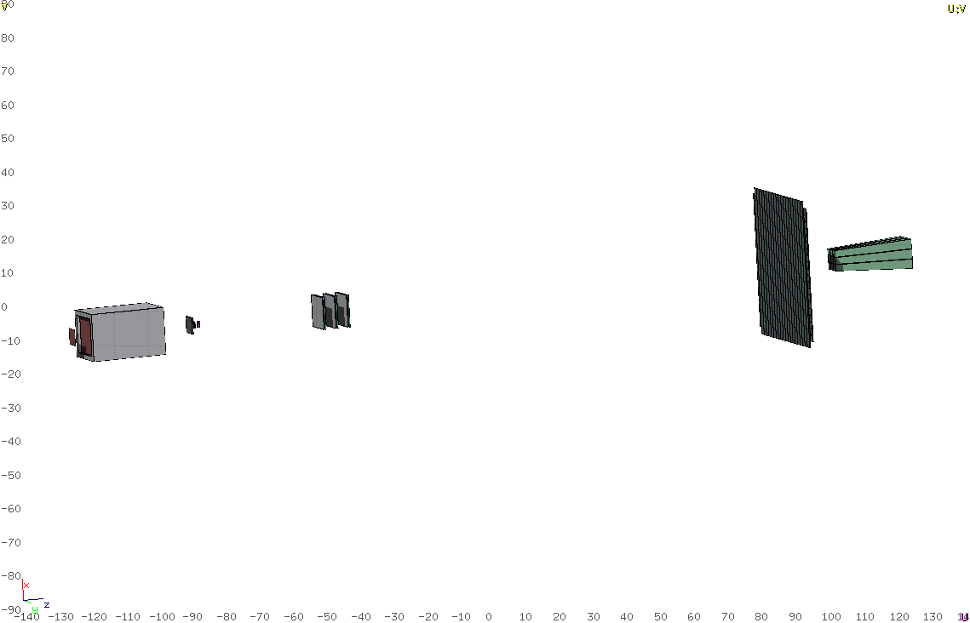
Goal
Analysis of data taken at GSI in 2021 of ¹⁶O 400 MeV/u and 200 MeV/u against C as target
Analysis integrated in SHOE and optimization for specific data
TW
BM
MSD
SC
VTX
CALO
TG
Specific goal:
Elemental fragmentation cross section
Angular differential cross section:

Slide 3
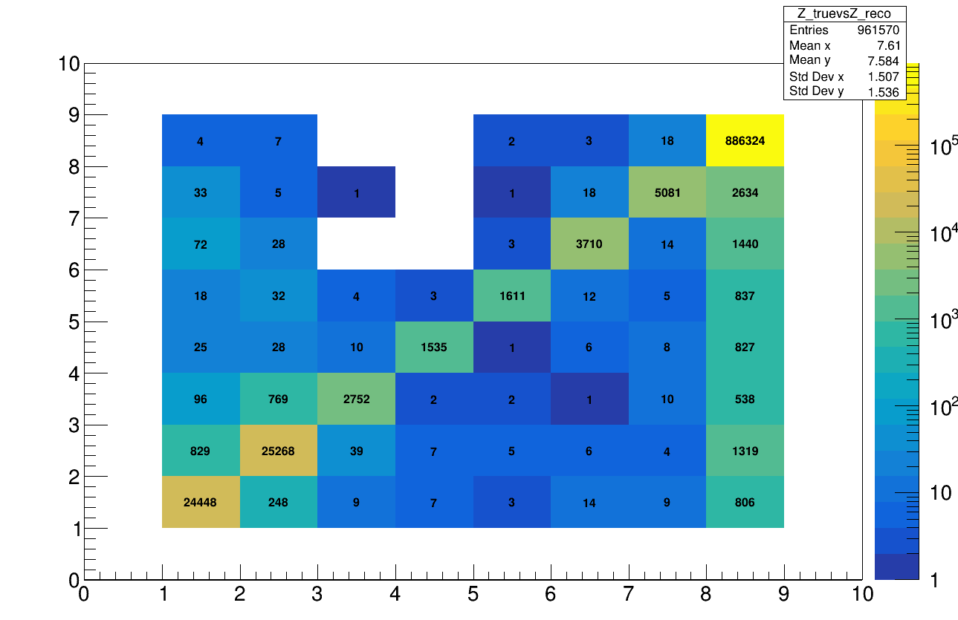
Reconstruction
Starting with MC data reconstructing fragment charge
Study of the MC tracks reconstructed by tracking algo
  Migration Matrix diagonal + misreconstruction
Z_{reco}
Mis-reconstruction around 1% for every charge
Main contribution of misreconstructed charge
for Z=8 and Z=1,2 → where the statistics is high
Z_{true}

Slide 4
Reconstruction
Starting with MC data reconstructing fragment charge
Study of the MC tracks reconstructed by tracking algo
  Migration Matrix diagonal + misreconstruction
Z_{reco}
Mis-reconstruction around 1% for every charge
Main contribution of misreconstructed charge
for Z=8 and Z=1,2 → where the statistics is high
First approximation → cut Z_{true} = 8 (simulation
of triggered dataset)
Z_{true}

Slide 5
Reconstruction, cuts
TW
BM
MSD
SC
VTX
CALO
TG
Cuts can be applied in order to make the migrant matrix more diagonal
Let’s inspect how charge is reconstructed in TW

Slide 6
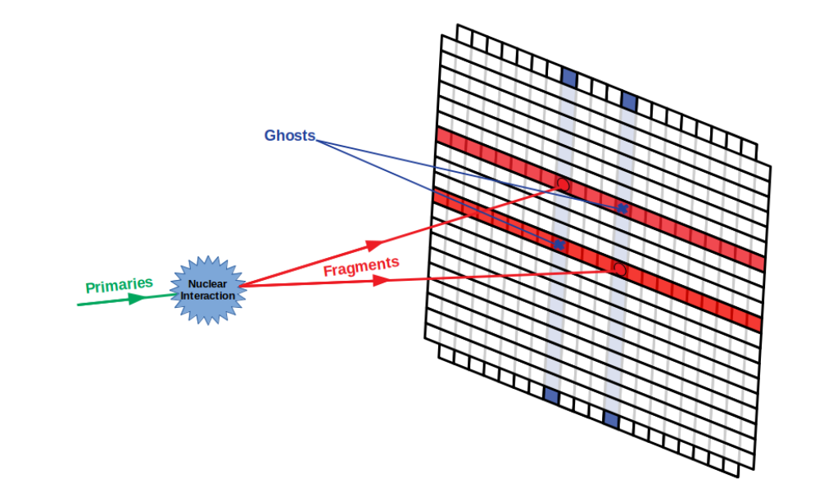
Reconstruction, Track Algo
One source of systematics could be the presence of Pile up / Ghost hits in the TW point of the track
twp→GetMcTracksN() > 1 :
The object TATWPoint is the superimposition
of the Hit_{x} and Hit_{y} on the rispective bars
It is possible that every bar is hitted with more than
a particle at the same time:
  Pile up
  Ghost hits
The reconstructed charge is then wrong because of
a wrong hits input
→ remove them asking GetMcTracksN() == 1

Slide 7
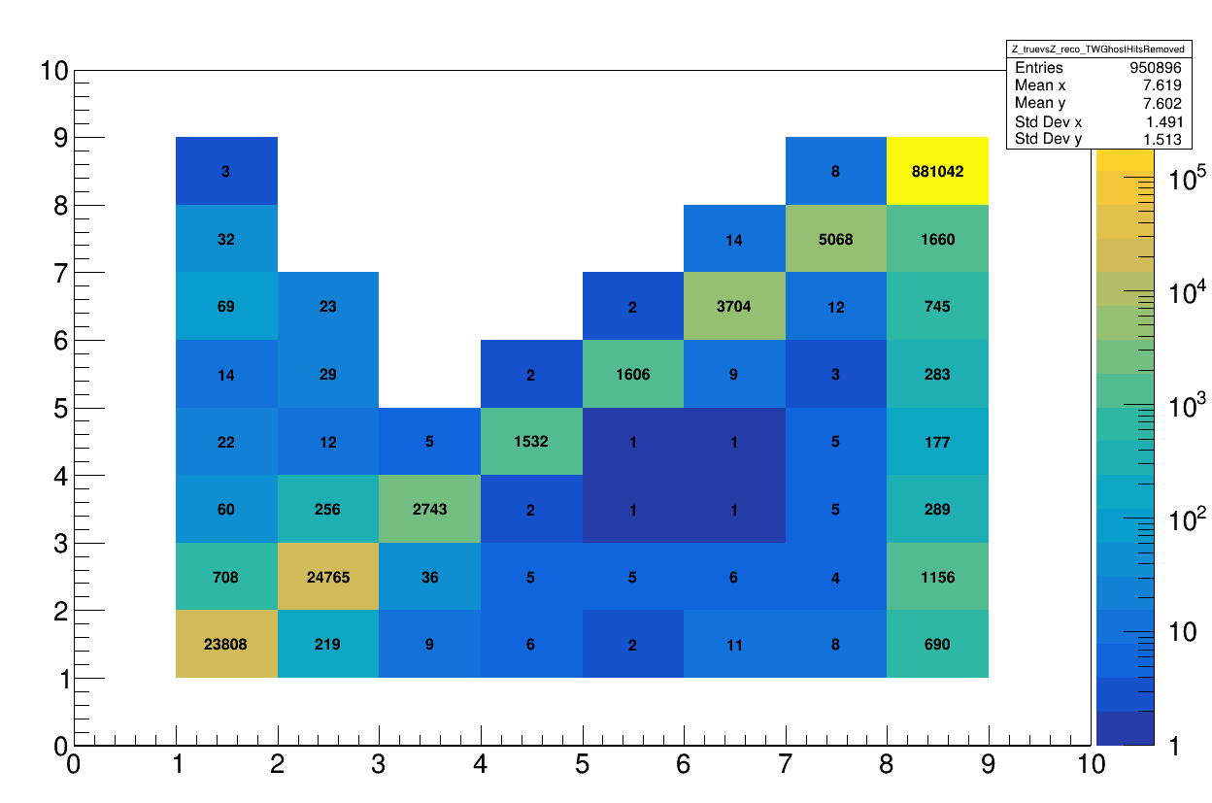
Reconstruction, Track Algo
Applying the TW Ghost Hits cut:
Z_{reco}
Z_{reco}
After cut:
Z_{true}
Z_{true}
Es Z=6
mis-reconstructed: 3%
Mis-reconstructed: 2.7%
TW ghost impact to be considered as a systematics/bkg

Slide 8

Reconstruction
TW ghost impact to be considered as a systematics/bkg

Slide 9
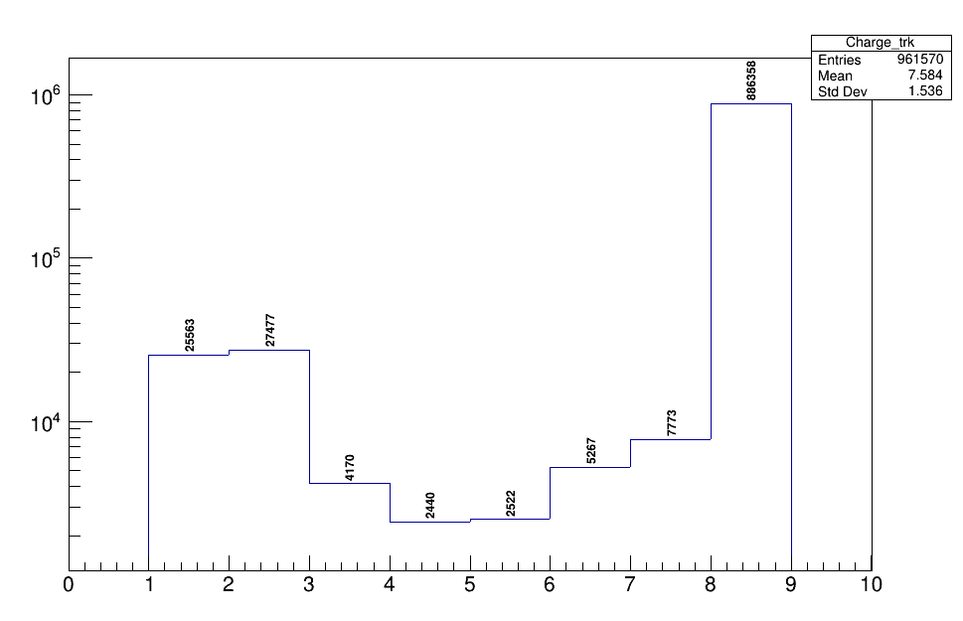
Reconstruction, Yield
Y(Z)
Z_{reco}
TW ghost impact to be considered as a systematics/bkg

Slide 10
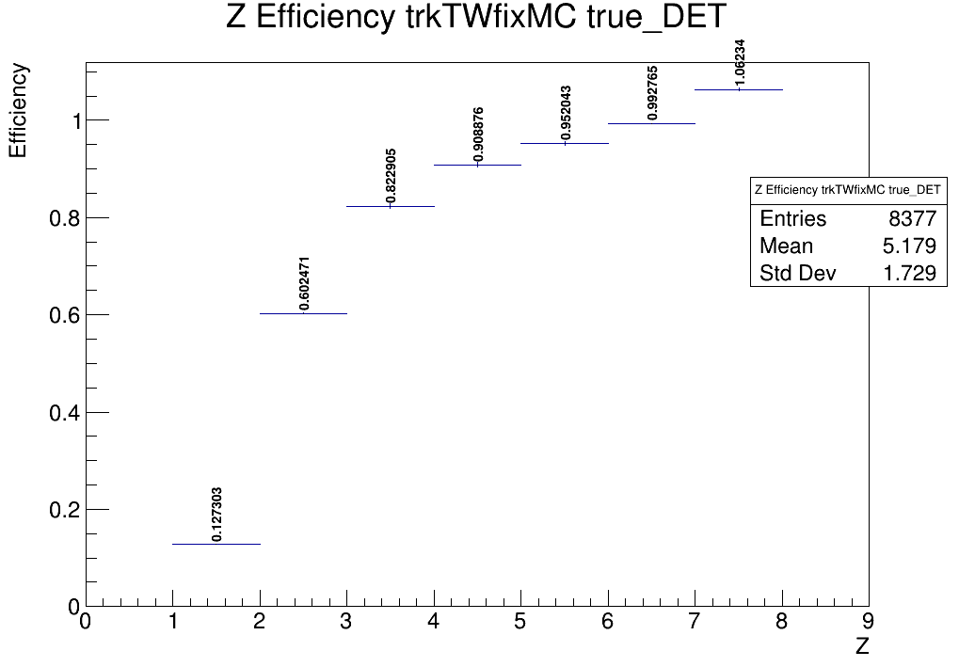
Reconstruction, efficiency
Reconstruction efficiency
reco tracks / simulated particles

Slide 11
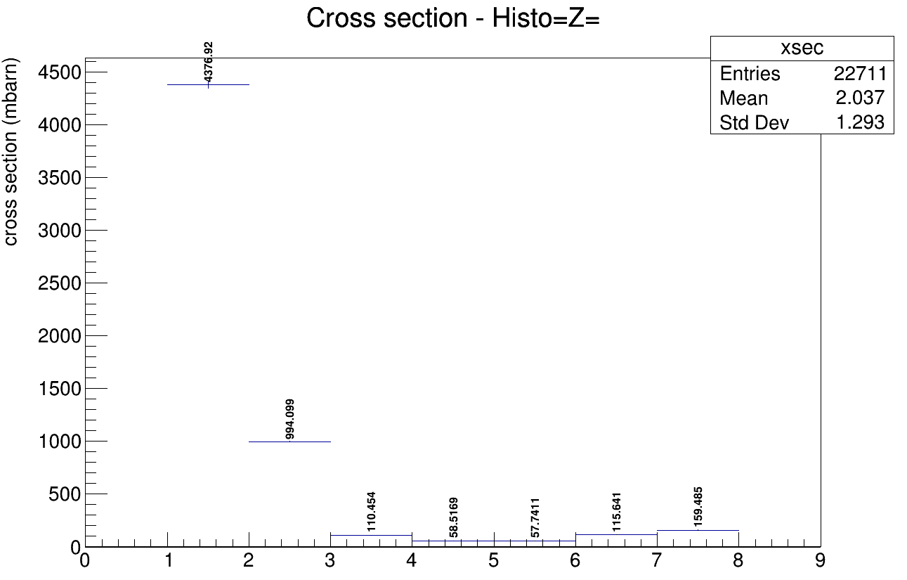
Elemental fragmentation cross section
Values of Z=1,2 depends
on the cut MC (es. angular acceptance)
Z

Slide 12
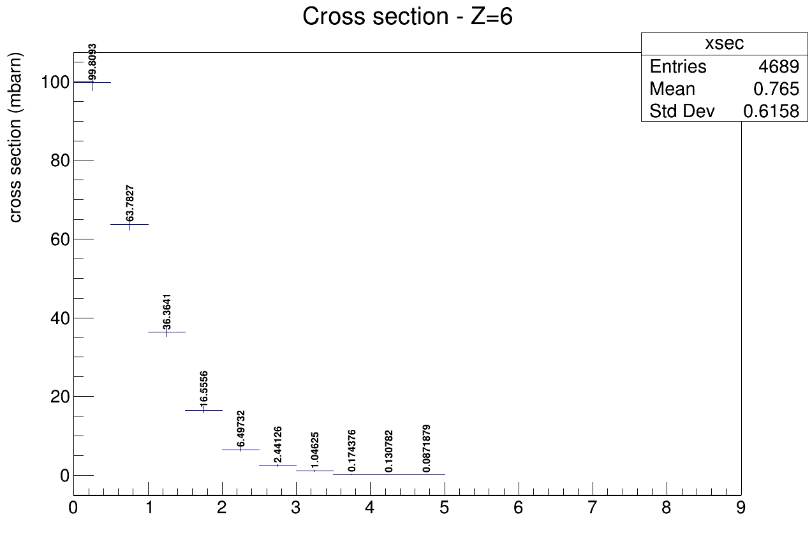
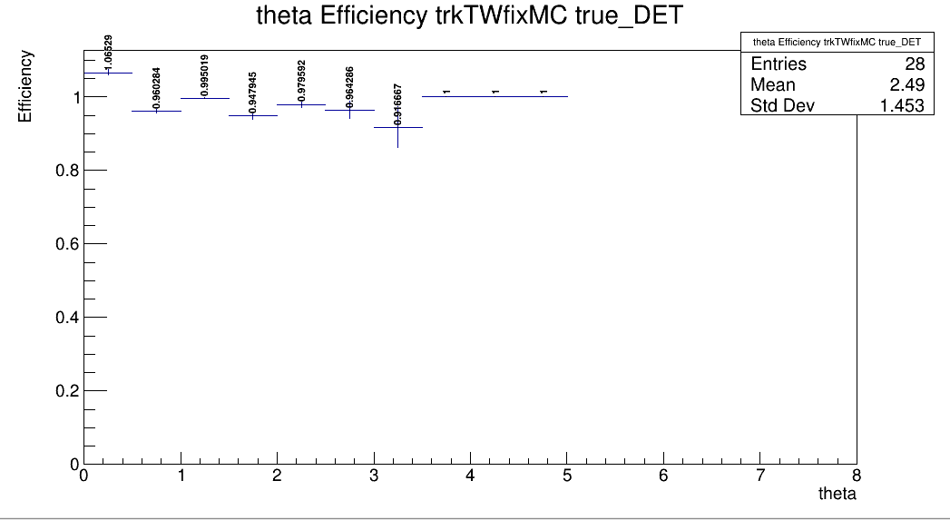
Angular differential cross section
Es Z=6
mbarn / degree°
Track efficiency
Theta (°)

Slide 13
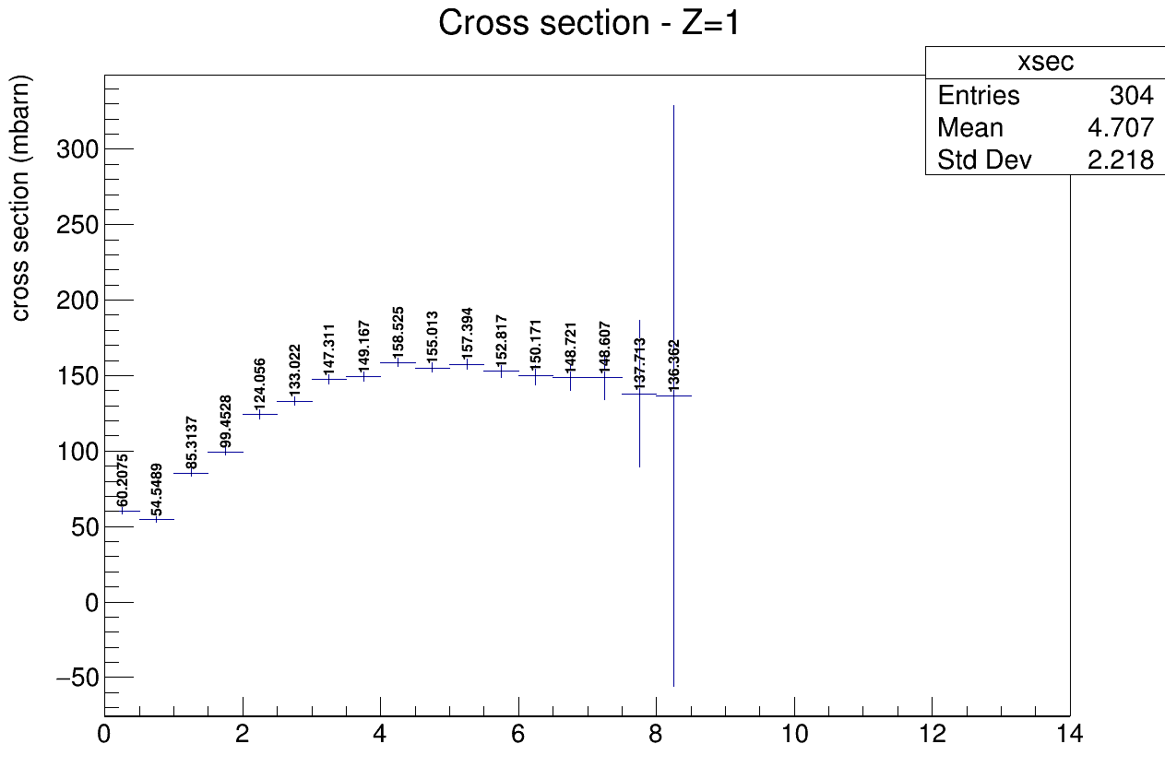
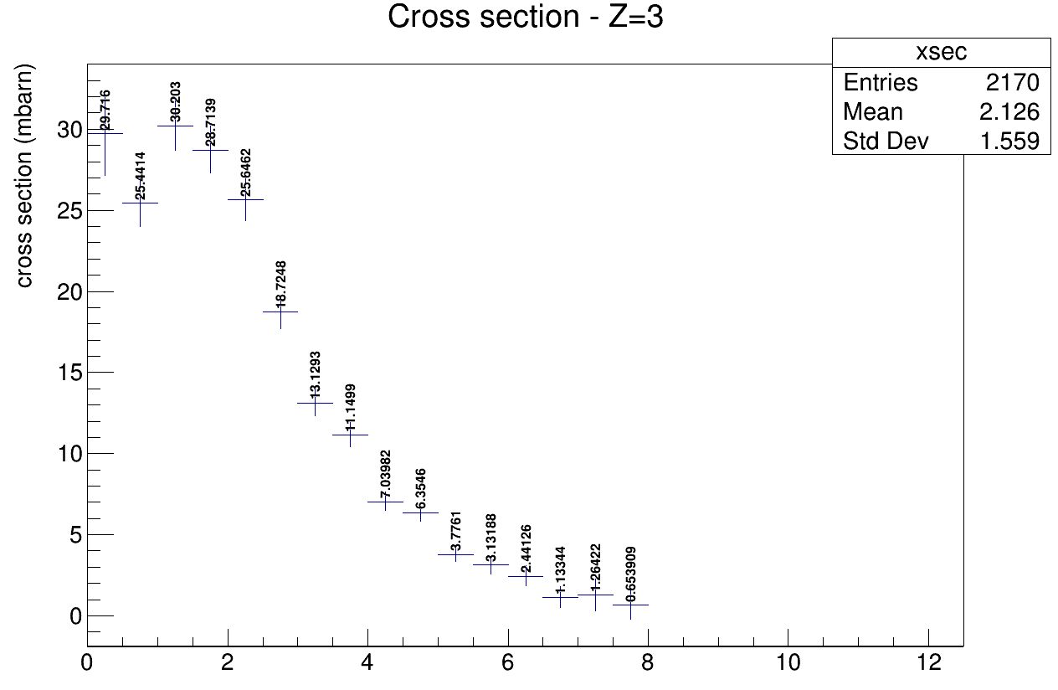
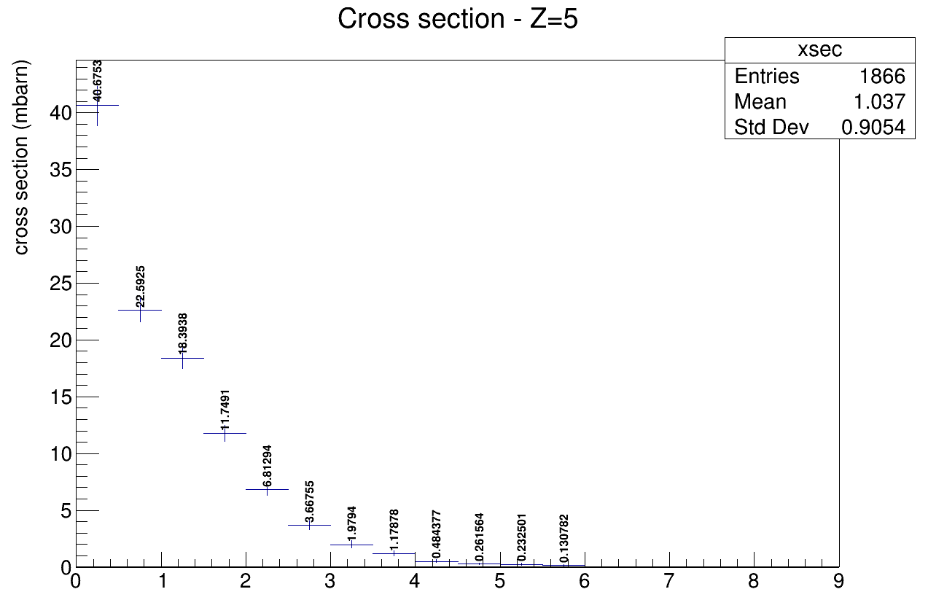
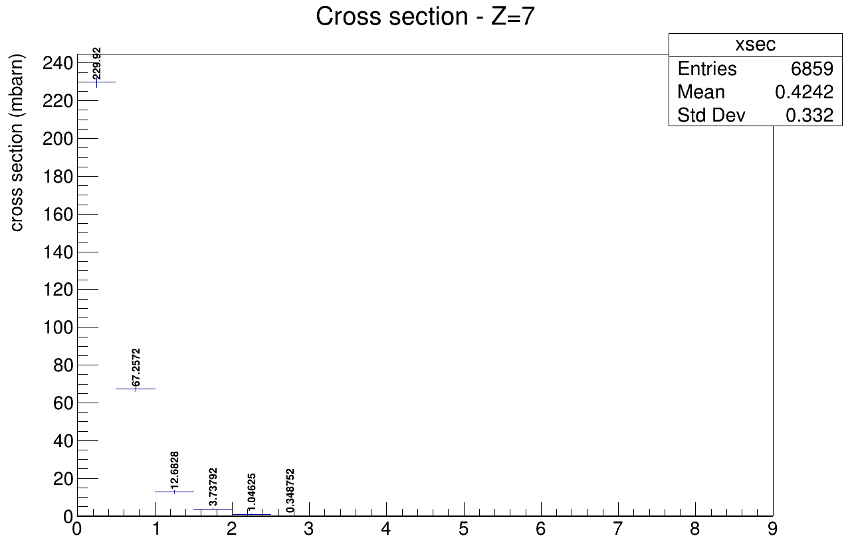
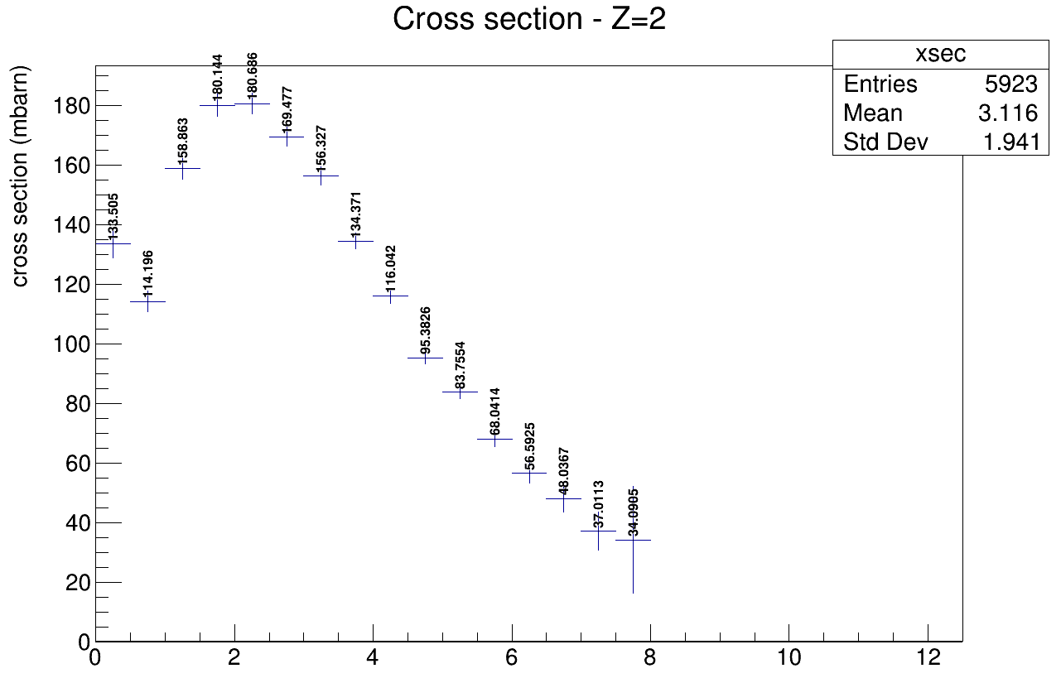
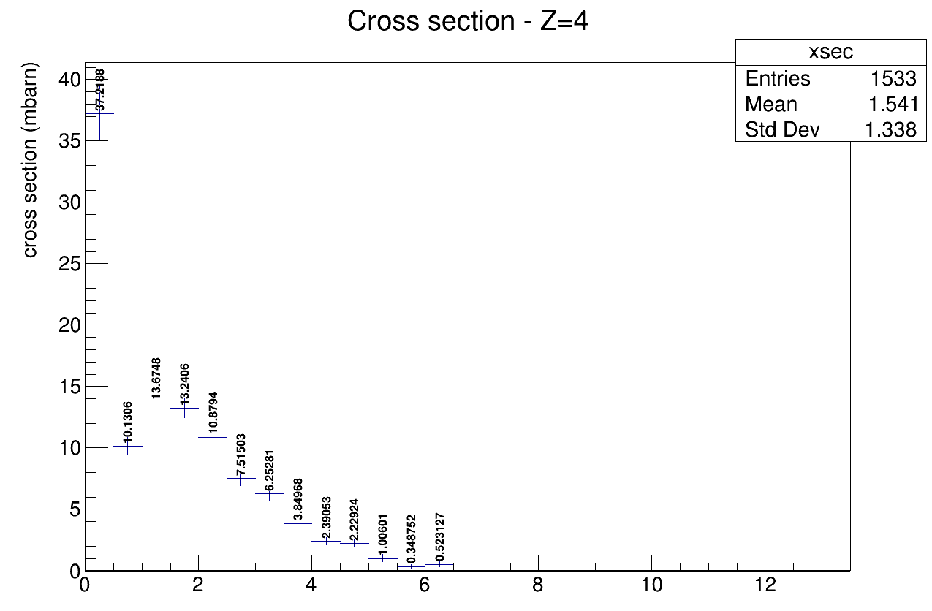
Angular differential cross section

Slide 14
Conclusions
First preliminary results based on MC events with a reasonable order of magnitude
To do:
Study of further efficiency and systematics due to TW and Track algorithm
Background to be considered: es fragmentation after target
Improve the simulation of trigger
Apply cross section “recipe” to real data

Slide 16
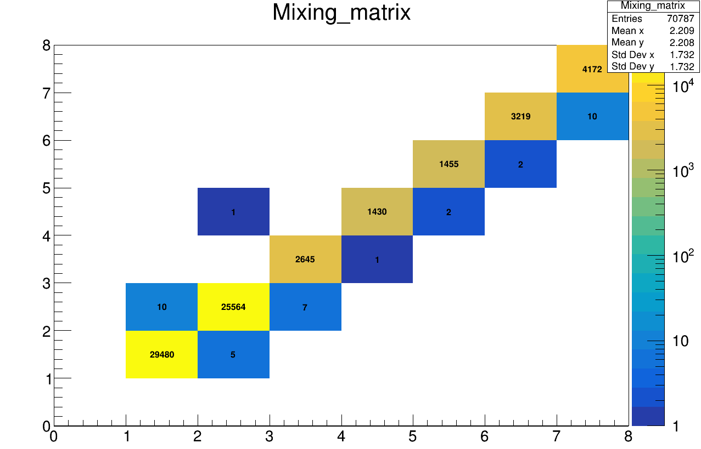
Reconstruction, TW Algo
Let’s study the MC particle, directly generated by the simulation
MC particles generated in TARGET which fragment after the TW → what can be detected by my apparatus
Z_{MC} vs Z_{TW-ALGO}
Z_{TW}
Much more diagonal
TW algo systematic is not the main problem
Z_{true}

Slide 17
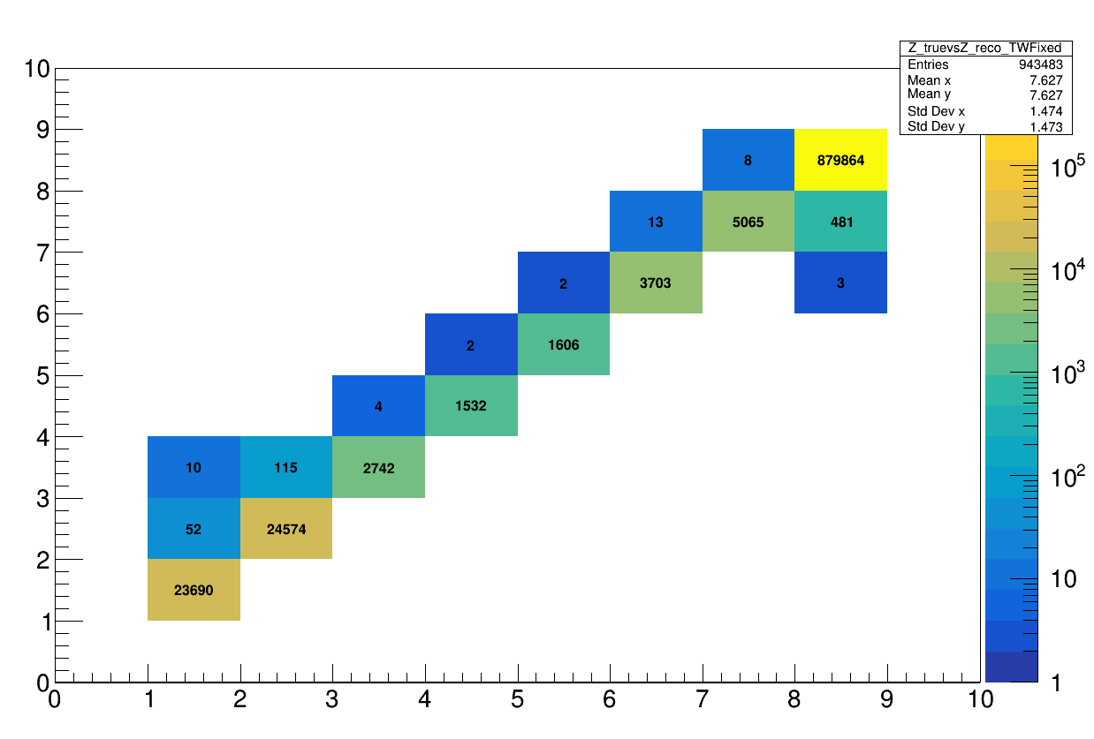
Reconstruction, efficiencies
9% of Z=7 are false
BKG subtraction?
After TW filter
Z_{reco}
Z_{true}

Slide 18
Reconstruction, Track Algo
Another source of systematics can be the way points are collected in a track
In the best scenario, all points belong to the same particle:
Reconstructed track:
x
x
x
x
x
x
x
x

Slide 19
Reconstruction, Track Algo
However, due to the presence of a lot of secondary fragmentation, some points can belong to other particles.
Reconstructed track:
x
x
x
x
x
x
x
x
Wrong points collected in the track
The McId of the track is given by the most present particle in the collection
However, if the TWPoint is of another particle → its McId is different
→ filter out all the tracks in which McId_{track} ≠ McId_{TWPoint}

Slide 20
Reconstruction, Track Algo
Applying the Id filter filter:
Z_{reco}
After filter:
Z_{reco}
Z_{true}
Z_{true}
Incidenza wrong points = 0.7%
Wrong point to be considered as a systematics
Incidenza TW (ghost + wrong points) = 2 %

Slide 21
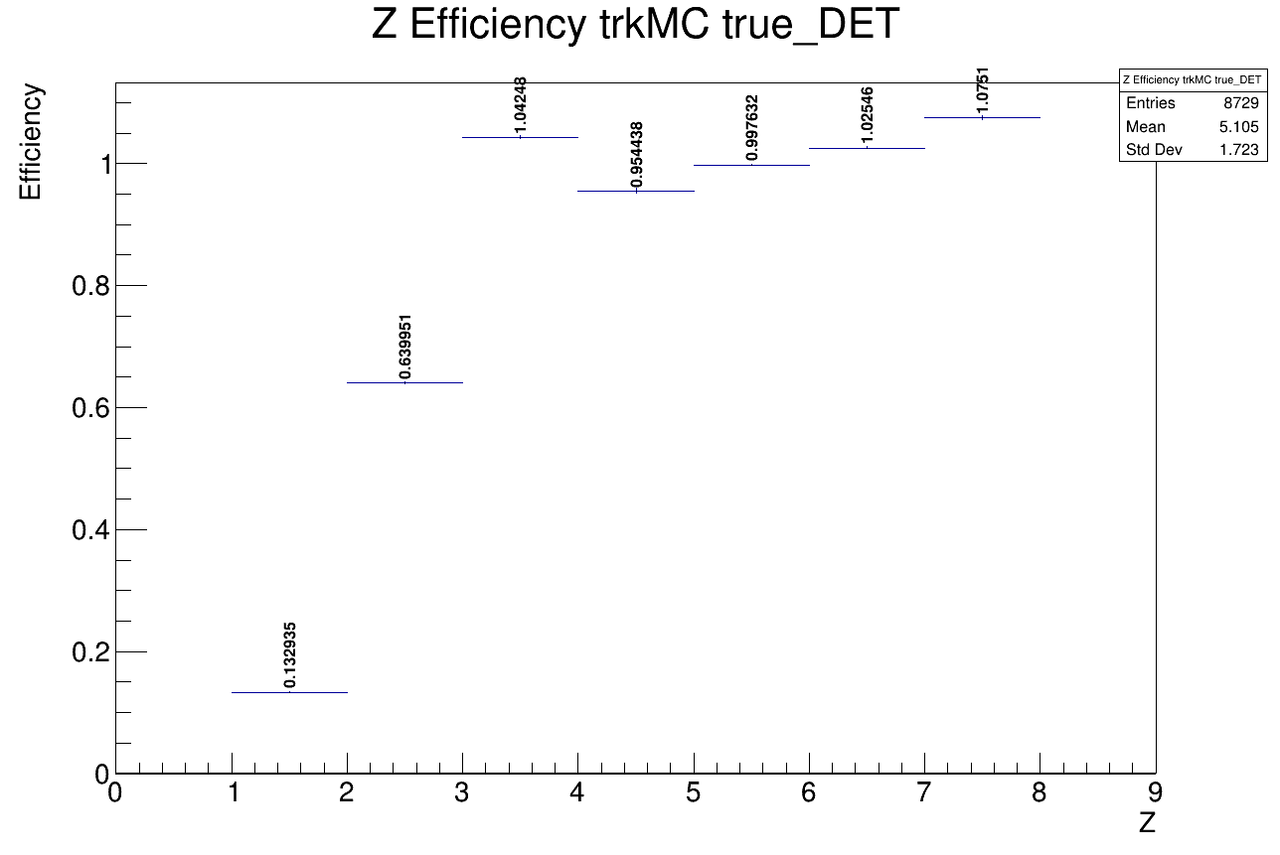
Reconstruction, efficiencies
Reconstruction efficiency
reco tracks / simulated particles
Before TW filter
After TW filter

Slide 22
Reconstruction, efficiencies
9% of Z=7 are false
BKG subtraction?
After TW filter
Z_{reco}
Z_{true}

Slide 24
Global reconstruction
Global reconstruction of an event
Particle ID: Z,A
Kinematics: E,p
Angular distribution: θ
From SHOE branch “glbreco_v1”:
libs/src/TAGfoot/GlobalRecoAna.cxx
.root file with histograms of
variable distribution
Aim of the new software:
Measure differential cross section σ (Z,A,θ,E)
wrt all combination of variables
Written in python
G. Ubaldi

Slide 25
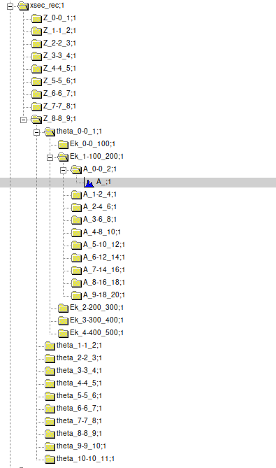
Z
Exampe of
Input file
From SHOE
θ
E
There are only histos of A
Every subdirectory is due to
input binning of the variable
Every histo is univocally discriminated
by its path
A
The software
takes info dinamically about input
variables and binning
Generates differential distribution
wrt all combinations of variables
G. Ubaldi

Slide 26
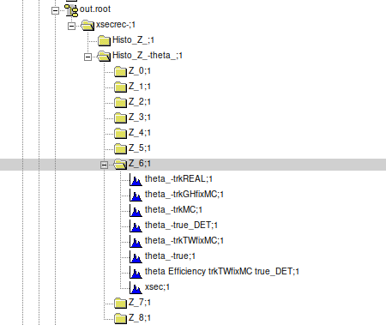
Output directories

Slide 27
https://baltig.infn.it/gubaldi/xshoe
G. Ubaldi

